Slide 1
بسم الله الرحمن الرحیم

Slide 2
Some needed Libraries
An extremely brief to introduction of Libraries
سید سروش حسین‌علی‌پور

Slide 3
Function Pointers
Designing Callbacks in C++

Slide 4
انگیزه

Slide 5
Callback is a function that we pass to another APIs as argument while calling them. Now these APIs are expected to use our provided callback at some point.

Slide 6
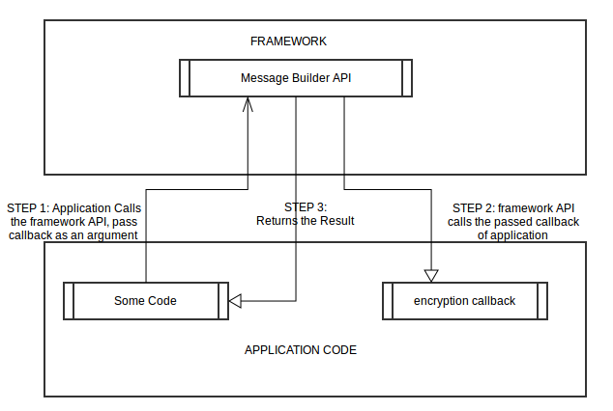

Slide 7
One Example
From a framework we got an API that can build complete message from provided raw data. This API will perform following steps
Add header and footer in raw Data to make the message.
Encrypt the complete message.
Return the message
Notes:
Now this API knows what header and footer to apply but don’t know about exact encryption logic, because that is not fixed to Framework, that can change from application to application. As, Encryption Logic is application dependent, therefore in this API provides a provision to pass encryption logic as a callback function pointer. This API will call back the code of application by calling this passed function pointer.

Slide 8
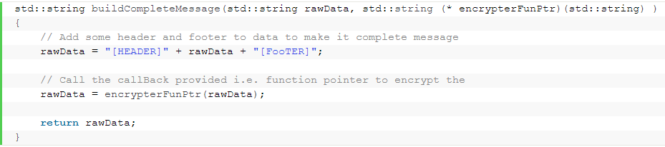
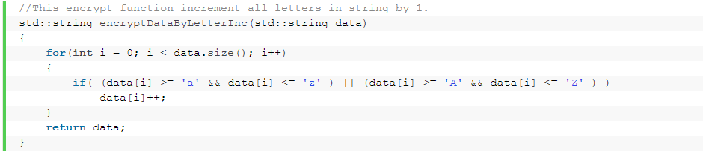
ادامه مثال

Slide 9
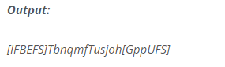

Slide 10
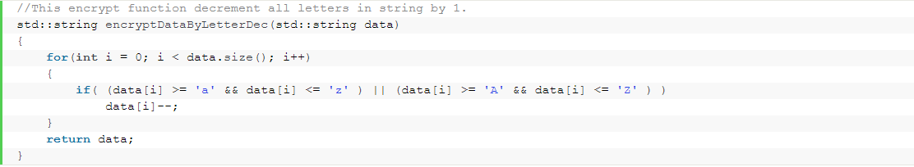
Another Encryptor

Slide 11
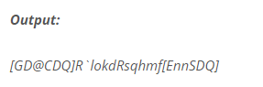

Slide 12
Designing Callbacks
Function Objects & Functors

Slide 13
Functor
A Function Object / Functor is a kind of Callback with State.
Object of a class which has overloaded operator() is called Function Object or Functor i.e. a class with overloaded operator() function is as follows

Slide 14
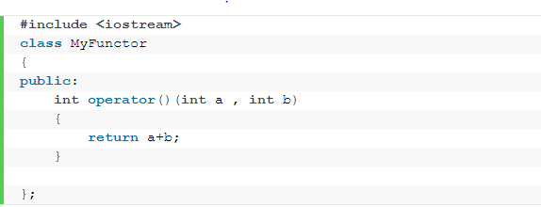
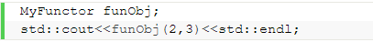
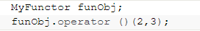

Slide 15
we want to call this framework API three times with three different types of encryption logics

Slide 16
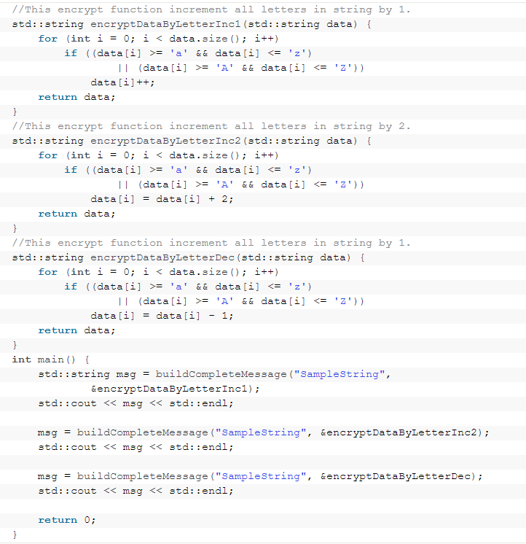

Slide 17
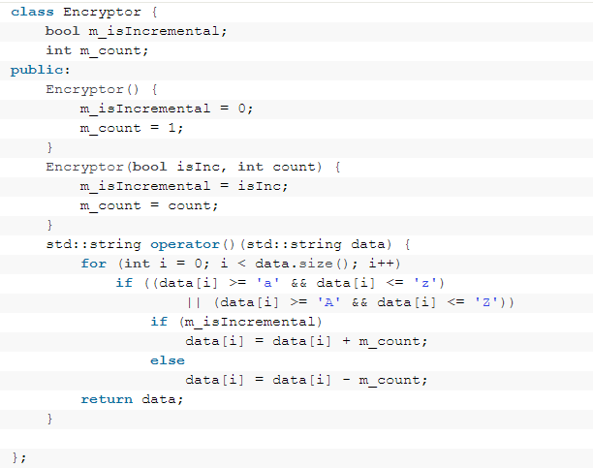
bind state with function pointers

Slide 18
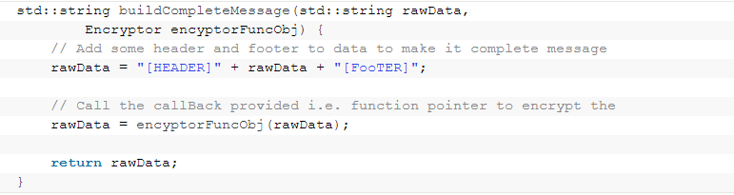

Slide 19
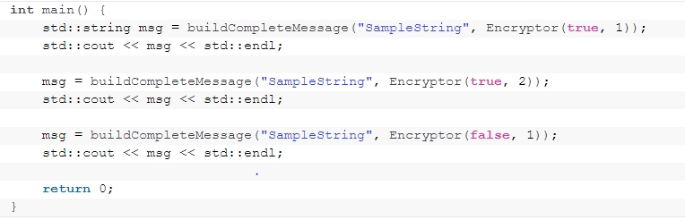

Slide 20
std::function
C++11: std::function and std::bind

Slide 21
Callable Target
A Callable type is a type for which the INVOKE operation is applicable. This operation may be performed explicitly using the library function std::invoke. (since C++17)
The type T satisfies Callable if
Given
f, an object of type T
ArgTypes, suitable list of argument types
R, suitable return type
The following expressions must be valid:

Slide 22
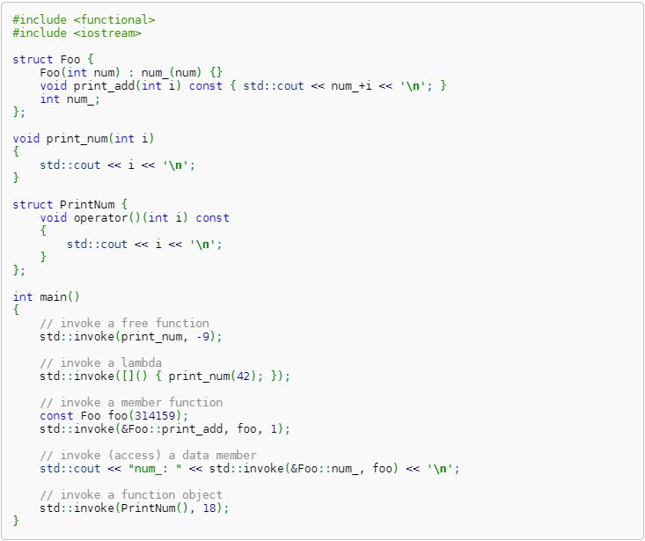

Slide 23
std::function and std::bind were born inside the Boost C++ Library, but they were incorporated into the new C++11 standard.
std::function is a STL template class that provides a very convenient wrapper to a simple function, to a functor or to a lambda expression.

Slide 24
Continue
Class template std::function is a general-purpose polymorphic function wrapper. Instances of std::function can store, copy, and invoke any Callable target
The stored callable object is called the target of std::function.
If a std::function contains no target, it is called empty. Invoking the target of an empty std::function results in std::bad_function_call exception being thrown.

Slide 25
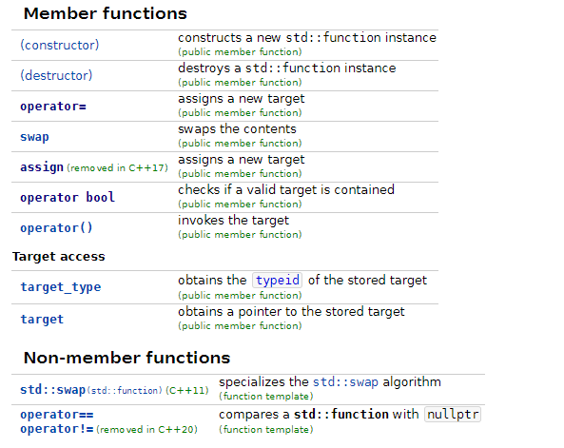

Slide 26
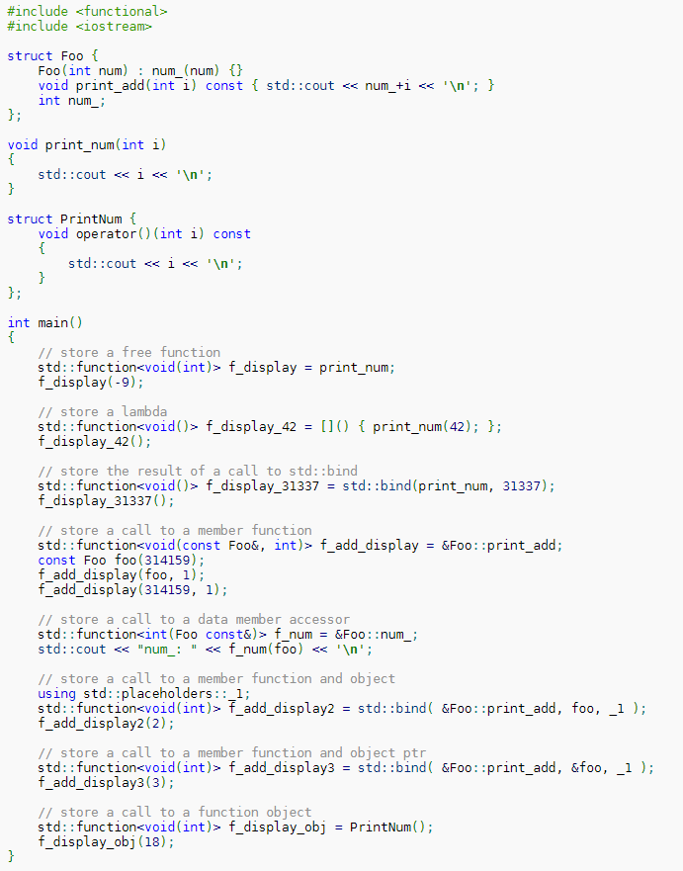

Slide 27
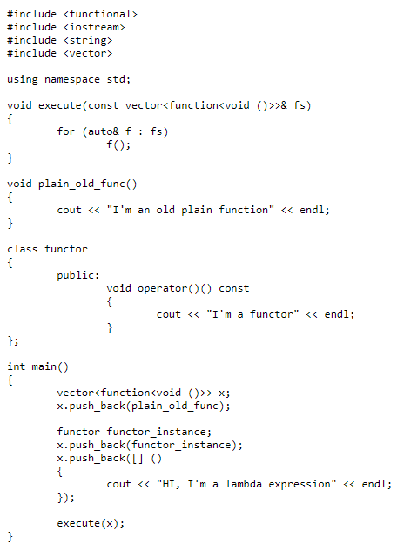

Slide 28
std::bind

Slide 29
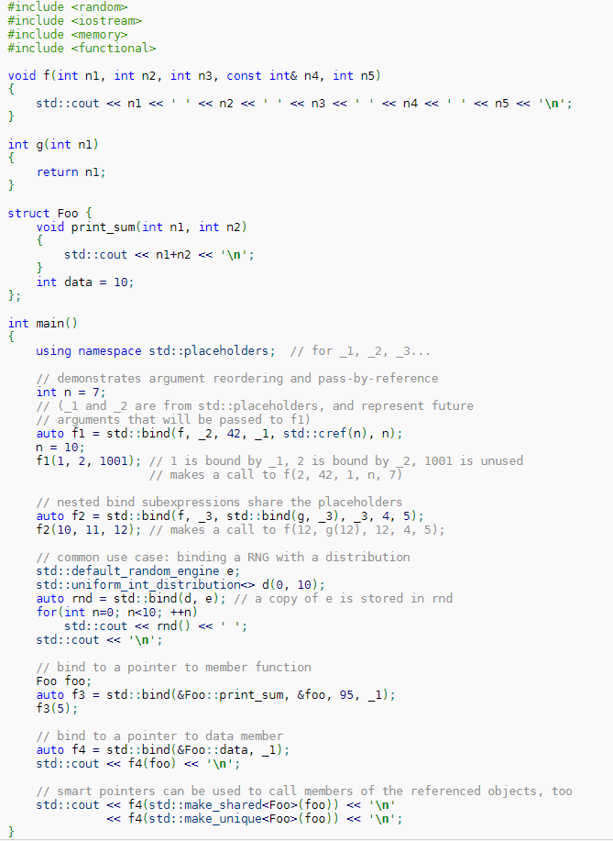

Slide 30
Lambda Expression

Slide 31
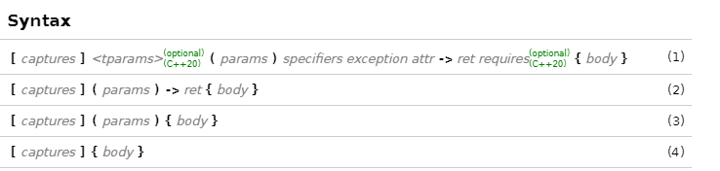

Slide 32
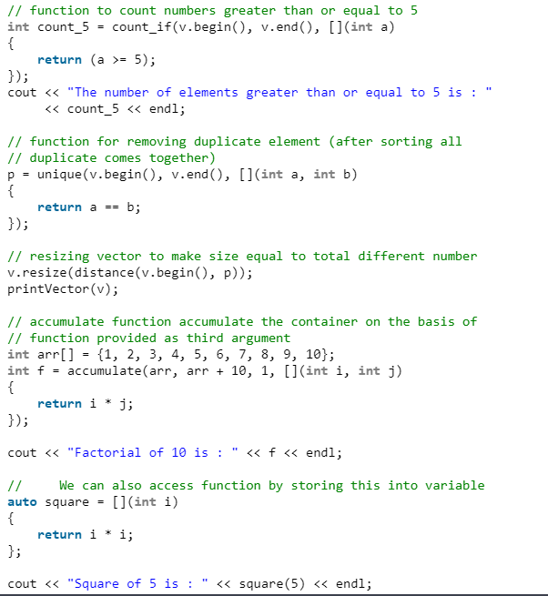

Slide 33
Capture
can capture external variables from enclosing scope by three ways :
Capture by reference
Capture by value
Capture by both (mixed capture)
Syntax used for capturing variables :
[&] : capture all external variable by reference
[=] : capture all external variable by value
[a, &b] : capture a by value and b by reference

Slide 34
std::thread

Slide 35
Each of the std::thread object has an associated ID and we can fetch using,
std::this_thread::get_id()

Slide 36
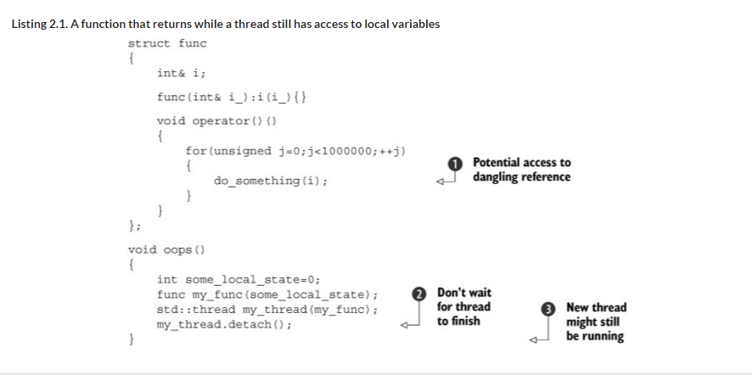

Slide 37
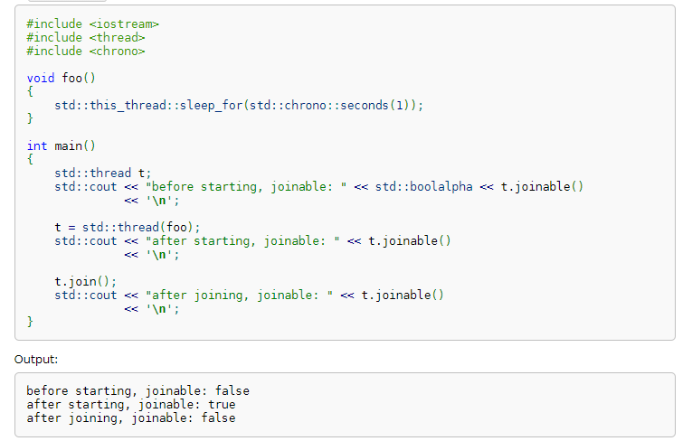
joinable
Checks if the std::thread object identifies an active thread of execution. Specifically, returns true if get_id() != std::thread::id()

Slide 38
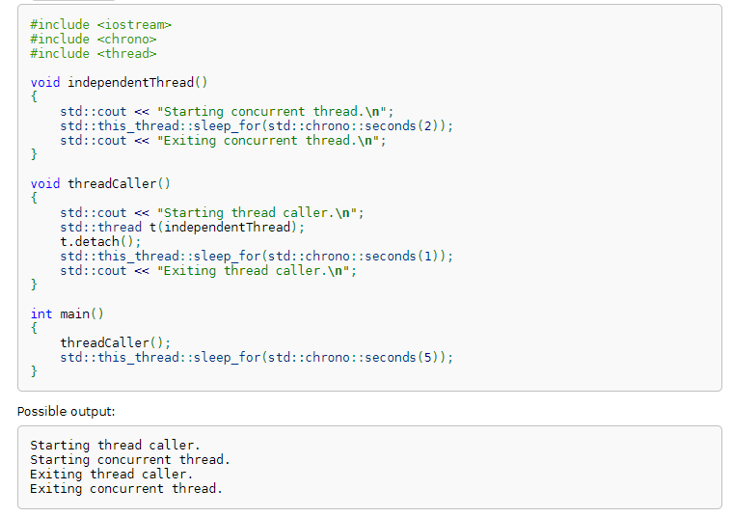
Detach

Slide 39
Race Condition

Slide 40
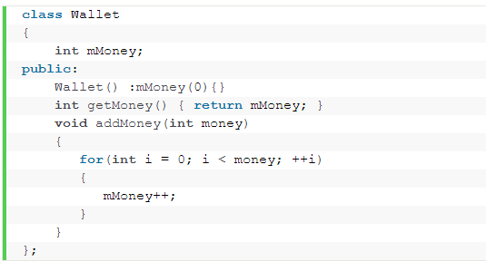

Slide 41
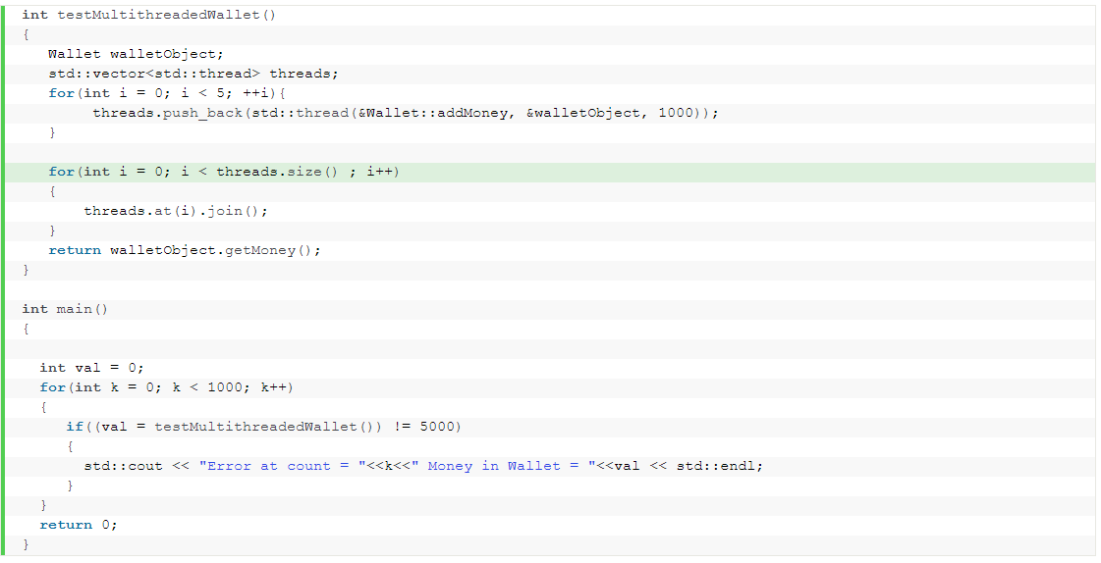

Slide 42
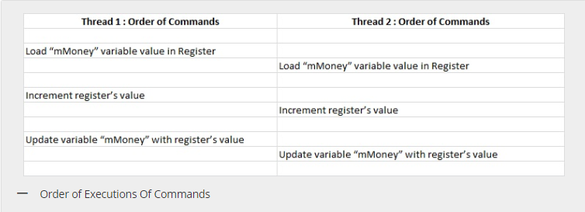
Why this happened
Load “mMoney” variable value in Register
Increment register’s value
Update variable “mMoney” with register’s value

Slide 43
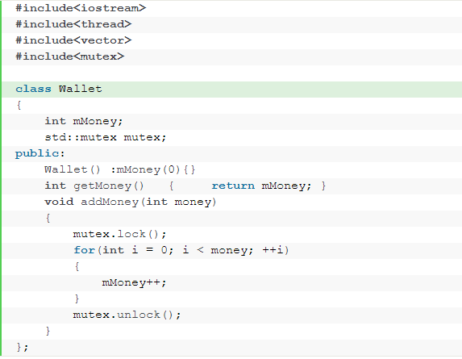

Slide 44
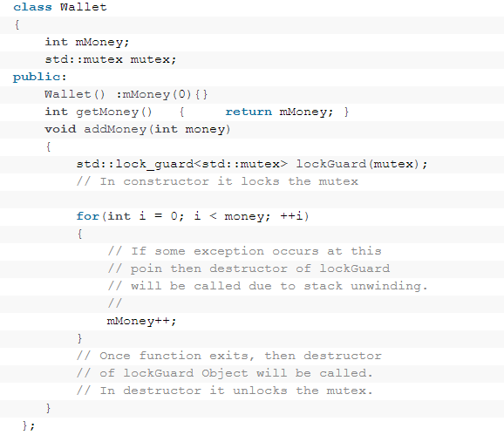

Slide 45
std::chrono

Slide 46
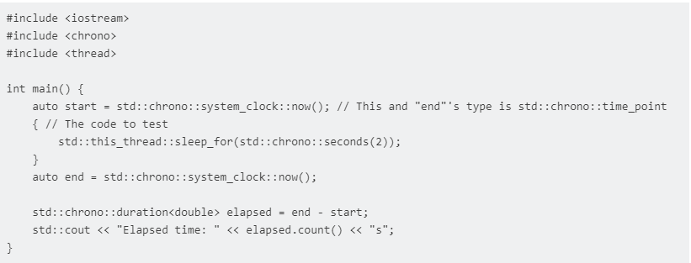

Slide 47
OPTARG
https://linux.die.net/man/3/optarg

Slide 48
What does int argc, char *argv[] mean?
argc will be the number of strings pointed to by argv
This will (in practice) be 1 plus the number of arguments, as virtually all implementations will prepend the name of the program to the array.

Slide 49
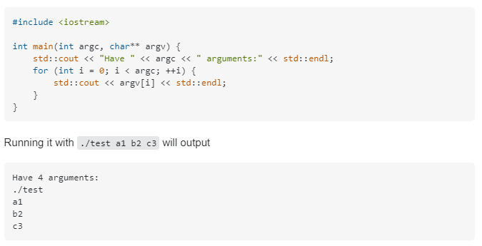

Slide 50
Syntax
If the option takes a value, then that value will be pointed by optarg.
It will return -1, when no more options to process
Returns ‘?’ to show that this is an unrecognized option, it stores it to optopt.
Sometimes some options need some value, If the option is present but the values are not there, then also it will return ‘?’. We can use ‘:’ as the first character of the optstring, so in that time, it will return ‘:’ instead of ‘?’ if no value is given.

Slide 51
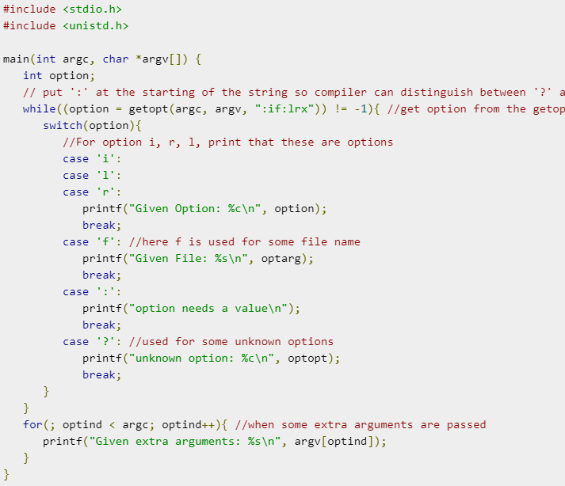

Slide 52
